Slide 1
COMM 644 Web Programming Intermediate
Zak Ruvalcaba
Lecture 11
zruvalca@sdccd.edu LinkedIn: linkedin.com/in/zakruvalcaba

Slide 2
This lecture at a glance…
This lecture at a glance…
Introduction to AJAX
The XMLHttpRequest Object
Loading XML Data
Loading JSON Data
Using Web APIs
Promises
The Fetch API
Async / Await
Making Cross Origin Requests
Lab 18: The (Console-Based) Employee Management Application v2

Slide 3
Introduction to AJAX

Slide 4
Introduction to AJAX
Introduction to AJAX
AJAX stands for Asynchronous JavaScript and XML.
Unlike normal HTTP requests, AJAX lets you receive data from a web server without reloading the page. This is sometimes known as a 'partial page refresh.'
JavaScript is essential to the use of AJAX because JavaScript not only sends the requests but also processes the responses and updates the DOM with the new data.
To send an AJAX request, JavaScript uses either the traditional XMLHttpRequest (XHR) object or the newer Fetch API which is nothing more than 'syntactic sugar' for the XMLHttpRequest object.
An XHR object is almost always processed by a server-side application. Those applications usually provide APIs that also let you use AJAX to get data from their sites. We'll look at one of these in this lecture so that we can practice with.

Slide 5
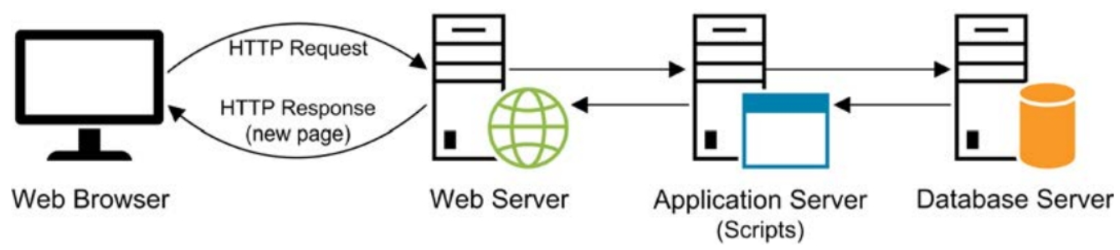
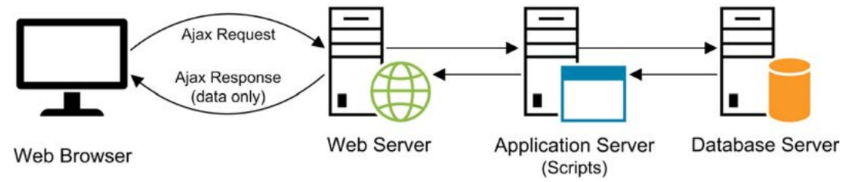
Introduction to AJAX
Introduction to AJAX
How a normal HTTP request is processed
How an AJAX request is processed

Slide 6
Introduction to AJAX
Common data formats for AJAX
The common data formats for working with AJAX are HTML (uncommon), XML (rarely used anymore), and JSON (very common):
XML eXtensible Markup Language (XML) is an open-standard, device-independent format that must be parsed by JavaScript in the browser.
JSON JavaScript Object Notation (JSON) is now the most popular format for AJAX applications. JSON files are smaller and faster than XML files. They are also easier to parse since JSON data is returned as native JavaScript objects.

Slide 7
Introduction to AJAX
Example of XML data
This is an example of a simple XML file that contains a parent node (management) and 2 child nodes (teammember). Each child node also contains 3 nodes including name, title, and bio.
<management> <teammember> <name>Agnes</name> <title>Vice President of Accounting</title> <bio>With over 14 years of public accounting ... </bio> </teammember> <teammember> <name>Wilbur</name> <title>Founder and CEO</title> <bio>While Wilbur is the founder and CEO ... </bio> </teammember> </management>

Slide 8
Introduction to AJAX
Example of JSON data
This is an example of a simple JSON file that contains a single high-level object called teammembers. Then, there are 2 nested objects. Each nested object has a property and a value.
{'teammembers':[
{
'name':'Agnes',
'title':'Vice President of Accounting',
'bio':'With over 14 years of public accounting... '
},
{
'name':'Wilbur',
'title':'Founder and CEO',
'bio':'While Wilbur is the founder and CEO ... '
}
]}
(in fact, you don’t need the ‘teammembers’[ part at the top – just the brackets are sufficient

Slide 9
The XMLHttpRequest Object

Slide 10
The XMLHttpRequest Object
Introduction to the XMLHttpRequest Object
AJAX communication is handled in JavaScript by the XMLHttpRequest (XHR) object. Yes, you can use the Fetch API as well, but under the hood, the XMLHttpRequest object is used.
Like server-side traffic, AJAX communication is broken down into requests and responses.
The XHR object was designed by Microsoft (originally for Outlook Web Access) and later adopted by Mozilla, Apple, Google, and others. It's now standardized by both the W3C and the WHATWG.
This object can include data that tells the server what data is being requested and how the data should be processed.
Despite its name, XHR can be used to retrieve any type of data, not just XML (i.e. JSON and HTML), and it supports protocols other than HTTP as well.
An XHR object is often processed by a server-side application.

Slide 11
The XMLHttpRequest Object
Common members of the XMLHttpRequest object
The following list represents the most common request members of the XMLHttpRequest object.
Member | Description
.open(method,url,async,user,pass) | Opens a connection for a request at the specified URL. Specify the method as either GET or POST and whether or not the transmission should be asynchronous (true) or synchronous (false). Always set to asychronous
.setRequestHeader(name,value) | Specifies a header name and value for a request header.
timeout | Number in milliseconds representing how long a request can take before automatically being terminated. A value of 0 (default) means there is no timeout.
.send([data]) | Starts the request. This method can include data that gets sent with the request. This method must be called after a request connection has been opened. Use: .send() for GET requests .send([data]) for POST requests. POST:Submits data to be processed
.abort() | Cancels the current request.

Slide 12
The XMLHttpRequest Object
Common members of the XMLHttpRequest object
The following list represents the most common response members of the XMLHttpRequest object.
Property | Description
responseURL | Represents the URL that returned the data in the response.
status | The status code returned from the server in numeric format. Common values include: 200 for OK 404 for Page not found.
statusText | The status message returned from the server in text format.
.getResponseHeader(name) | Returns the value of a specific response header.
.getAllResponseHeaders() | Returns a string that contains the names and values of all response headers.
readyState | A numeric value that indicates the state of the current request: 0 is UNSENT 1 is OPENED 2 is HEADERS_RECEIVED 3 is LOADING 4 is DONE
responseType | Enumerated value that defines the response type. Possible values include json, text, document, etc.
responseText | The content that’s returned from the server in plain text format. Rarely will use this.
responseXml | The content that’s returned from the server in XML format.
Response | Used when working with JSON

Slide 13
The XMLHttpRequest Object
Common members of the XMLHttpRequest object
The following list represents all of the events supported by the XMLHttpRequest object.
Event | Description
readystatechange | An event that occurs when the state of the request changes.
loadstart | An event that occurs once the transmission has been initiated.
progress | An event that occurs during the transmission of data.
abort | An event that occurs when the request has been aborted.
error | An event that occurs when the request fails.
load | An event that occurs once the request succeeds in fetching the data.
timeout | An event that occurs once the developer's pre-set timeout has passed.
loadend | An event that occurs once the request either fails or succeeds in fetching data.

Slide 14
Loading XML Data

Slide 15
The XMLHttpRequest Object
Creating a new instance of the XHR object
In this example, a new instance of the XHR object is created and stored within an object variable named xhr.
// Create a new instance of the XMLHttpRequest() object
const xhr = new XMLHttpRequest();

Slide 16
The XMLHttpRequest Object
Opening a connection to an XML file
The .open() method is used to point to the XML file that will be fetched and to set the method used for requesting the data (GET in this case). Then, the .send() method is called to initiate the request.
// Create a new instance of the XMLHttpRequest() object
const xhr = new XMLHttpRequest();
// Open the connection
xhr.open('GET', 'team.xml');
// Initiate the request
xhr.send();

Slide 17
The XMLHttpRequest Object
Handling the state change of the request
The readystatechange event is used to handle the state change of the request. All of the code for iterating through the loaded XML file will be written within this event handler function.
const xhr = new XMLHttpRequest();
xhr.onreadystatechange = () => {
}
xhr.open('GET', 'team.xml');
xhr.send();

Slide 18
The XMLHttpRequest Object
Check and see if the fetch was successful
The readyState and status properties can now be checked to see if the fetch to the server was successful. If a 4 is received (Done) and a status of 200 is received (OK), then we can go ahead and iterate through the returned data. Otherwise, you'll need to output some kind of failure error back to the user (not shown).
const xhr = new XMLHttpRequest();
xhr.onreadystatechange = () => {
if (xhr.readyState == 4 && xhr.status == 200) {
console.log(xhr.responseXML);
}
}
xhr.open('GET', 'team.xml');
xhr.send();

Slide 19
The XMLHttpRequest Object
Iterating through the returned XML data
... xhr.onreadystatechange = () => {
if (xhr.readyState == 4 && xhr.status == 200) {
let xmlDoc = xhr.responseXML;
let team = xmlDoc.getElementsByTagName('teammember');
for (let i = 0; i < team.length; i++) {
document.body.innerHTML +=
xmlDoc.getElementsByTagName('name')[i].childNodes[0].nodeValue + '<br>' +
xmlDoc.getElementsByTagName('title')[i].childNodes[0].nodeValue + '<br>' +
xmlDoc.getElementsByTagName('bio')[i].childNodes[0].nodeValue + '<br><br>');
}
}
} ...

Slide 20
The XMLHttpRequest Object
Handling potential errors
... xhr.onreadystatechange = () => {
if (xhr.readyState == 4 && xhr.status == 200) {
let xmlDoc = xhr.responseXML;
let team = xmlDoc.getElementsByTagName('teammember');
for (let i = 0; i < team.length; i++) {
document.body.innerHTML +=
xmlDoc.getElementsByTagName('name')[i].childNodes[0].nodeValue + '<br>' +
xmlDoc.getElementsByTagName('title')[i].childNodes[0].nodeValue + '<br>' +
xmlDoc.getElementsByTagName('bio')[i].childNodes[0].nodeValue + '<br><br>');
}
}
}
xhr.onerror = (e) => {console.error(e.message)}; ...

Slide 21
Loading JSON Data

Slide 22
Consuming JSON Data
Creating a new instance of the XHR object
In this example, a new instance of the XHR object is created and stored within an object variable named xhr. Next, the response type is set to 'json'. This way the browser knows to handle the data contained in the response stream as JSON data.
// Create a new instance of the XMLHttpRequest() object const xhr = new XMLHttpRequest();
// Set the response type to json
xhr.responseType = 'json';

Slide 23
Consuming JSON Data
Opening a connection to a JSON file
The .open() method is used to point to the JSON file that will be fetched and to set the method used for requesting the data (GET in this case). Then, the .send() method is called to initiate the request.
// Create a new instance of the XMLHttpRequest() object const xhr = new XMLHttpRequest();
// Set the response type to json
xhr.responseType = 'json';
// Open the connection xhr.open('GET', 'data/team.json');
// Initiate the request xhr.send();

Slide 24
Consuming JSON Data
Handling the state change of the request
The readystatechange event is used to handle the state change of the request. All of the code for iterating through the loaded JSON file will be written within this event handler function.
const xhr = new XMLHttpRequest();
xhr.responseType = 'json';
xhr.open('GET', 'data/team.json');
xhr.addEventListener('readystatechange', () => { });
xhr.send();

Slide 25
Consuming JSON Data
Check and see if the fetch was successful
The readyState and status properties can now be checked to see if the fetch to the server was successful. If a 4 is received (Done) and a status of 200 is received (OK), then we can go ahead and iterate through the returned data. Otherwise, you'll need to output some kind of failure error back to the user (not shown).
const xhr = new XMLHttpRequest();
xhr.responseType = 'json';
xhr.open('GET', 'data/team.json');
xhr.addEventListener('readystatechange', () => {
if (xhr.readyState === 4 && xhr.status === 200) { }
});
xhr.send();

Slide 26
Consuming JSON Data
Iterating through the returned JSON data
const xhr = new XMLHttpRequest();
xhr.responseType = 'json';
xhr.open('GET', 'data/team.json');
xhr.addEventListener('readystatechange', () => {
if (xhr.readyState === 4 && xhr.status === 200) {
let employees = xhr.response;
for (let employee of employees) {
document.body.innerHTML += `${employee.name}<br>${employee.title}'<br><br>'`;
}
}
});
xhr.onerror = (e) => {console.error(e.message)};
xhr.send();

Slide 27
Using Web APIs

Slide 28
Using Web APIs
Using Web APIs to practice loading data into an application
Ajax requests typically get data from a web service API.
If you're not ready to build your own API, there are several free APIs that you can use. JSON Placeholder and ReqRes are two examples of free web service APIs that you can use to practice making asynchronous calls within your applications.
These web services provide an API that accesses fake data that's in JSON format. This data mimics the kind of data that's typically returned by real web services.
Using APIs like these allow you to practice making Ajax calls without having to set up accounts or worry about other implementation details.
We would learn how to do this (create Web APIs) in the Full Stack FEWD program next Spring

Slide 29
Using Web APIs
The JSON Placeholder API
The fake data that’s available from the JSON Placeholder API
To select all users then, you would use the URL: https://jsonplaceholder.typicode.com/users
Resource | Description
/users | 10 users with data such as name, username, and email address
/posts | 100 blog posts with each one related to a specific user.
/comments | 500 comments with each one related to a specific blog post.
/albums | 100 photo albums with each one related to a specific user.
/photos | 5000 simple photos of various colors with each one related to a specific album. This includes one photo that’s 600x600 pixels and a thumbnail that’s 150x150 pixels.
/todos | 200 tasks with each one related to a specific user.

Slide 30
Using Web APIs
Iterating through the JSON data returned from the JSON Placeholder API
const xhr = new XMLHttpRequest();
xhr.responseType = 'json';
xhr.open('GET', 'https://jsonplaceholder.typicode.com/users/');
xhr.addEventListener('readystatechange', () => {
if (xhr.readyState === 4 && xhr.status === 200) {
let users = xhr.response;
for (let user of users) {
document.body.innerHTML += `${user.name}<br>
<a href="mailto:${user.email}">${user.email}</a><br>
${user.phone}<br>${user.website}<br><br>`;
}
}
});
xhr.onerror = (e) => {console.error(e.message)};
xhr.send();

Slide 31
Promises

Slide 32
Promises
Introduction to Promises
A promise is an object that may produce a single value some time in the future: either a resolved value, or a reason that it’s not resolved (such as a network error occurred).
A promise may be in one of 3 possible states: pending (first created), fulfilled (request returns its value), or rejected (an error occurred).
A promise that is no longer pending is considered settled. This is true whether the promise is fulfilled or rejected. A promise can be resolved without being fulfilled.
Many JavaScript APIs will return Promise objects. The Fetch API, which we will use next, is one of these APIs.
Promise objects have special syntax that you use to handle the fulfilled value or the reason for rejection.

Slide 33
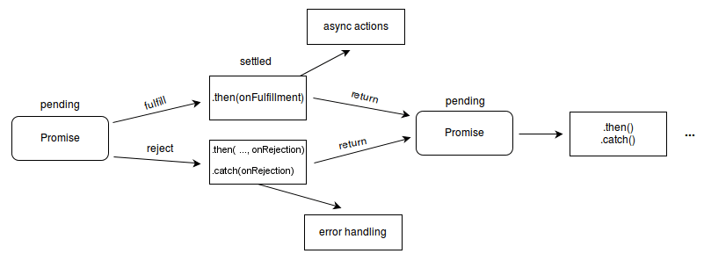
Promises
Introduction to Promises

Slide 34
Promises
Creating the Promise
const myFetch = (url) => {
return new Promise((resolve, reject) => {
const xhr = new XMLHttpRequest();
xhr.responseType = 'json';
xhr.onreadystatechange = () => {
if (xhr.readyState == 4) {
(xhr.status == 200) ? resolve(xhr.response) : reject(new Error(xhr.status));
}
};
xhr.open('GET', url);
xhr.send();
});
};

Slide 35
Promises
Using the Promise
myFetch('https://jsonplaceholder.typicode.com/users')
.then((users) => console.log(users))
.catch((e) => console.log(e));

Slide 36
The Fetch API

Slide 37
The Fetch API
Introduction to the Fetch API: The .fetch() method
The Fetch API provides methods and objects for making Ajax requests. For new development, it’s generally considered a best practice to use the Fetch API, not the older XMLHttpRequest object.
The main method in the Fetch API is the .fetch() method.
The .fetch() method accepts a URL for a GET request which returns a promise that resolves when the status and headers of the HTTP response are received:
fetch('https://jsonplaceholder.typicode.com/users')
At this point, the data of the HTTP response isn’t received yet. So, although this promise is resolved because it has returned a Response object, it isn’t fulfilled, because the requested data isn’t received yet.

Slide 38
The Fetch API
Introduction to the Fetch API: The first .then() method
The first .then() method accepts a callback that executes when the promise from the .fetch() method resolves. This callback function accepts the Response object as a parameter and then calls its json() method. This returns a second promise that resolves to a JavaScript object that’s created from the JSON stored in the response. At that point, the original promise is fulfilled:
fetch('https://jsonplaceholder.typicode.com/users')
.then( response => response.json())

Slide 39
The Fetch API
Introduction to the Fetch API: The second .then() method
The second .then() method accepts a callback that executes when the promise from the json() method resolves. This callback accepts a JavaScript object named users. The users object is iterated through and the data is displayed in the browser:
fetch('https://jsonplaceholder.typicode.com/users')
.then( response => response.json())
.then( users => {
for (let user of users) {
document.body.innerHTML += `user.name}<br>${user.email}<br>
${user.phone}<br>${user.website}<br><br>`;
}
});

Slide 40
The Fetch API
Introduction to the Fetch API: The .catch() method
The catch() method accepts a callback that executes when the promise is rejected. This callback function displays an error message in the console:
fetch('https://jsonplaceholder.typicode.com/users')
.then( response => response.json())
.then( users => {
for (let user of users) {
document.body.innerHTML += `user.name}<br>${user.email}<br>
${user.phone}<br>${user.website}<br><br>`;
}
})
.catch( e => console.log(e.message) );

Slide 41
Async / Await

Slide 42
Async / Await
Introduction to Async / Await
So far, you've seen how promises can make asynchronous code more readable.
Still, most developers are used to synchronous code, and code that works directly with promises just looks different, which can make it harder for some developers to understand.
Fortunately, the async and await keywords make asynchronous code look more like synchronous code. In turn, this makes working with promises even easier.

Slide 43
Async / Await
Introduction to Async / Await
When you define a function, you can use the async keyword to create an asynchronous function that wraps the return value of that function in a Promise object:
async function fetchUsers() {
}
fetchUsers();

Slide 44
Async / Await
Introduction to Async / Await
The await keyword tells JavaScript to wait until a promise is settled and then return its result. It can only be used in asynchronous functions. This example defines an asynchronous function named fetchUsers() that uses the fetch() method to get a collection of users from a Web API. Here, the await keyword is used prior to using the .fetch() method as well as collecting the response from response.json(). This makes this code look like "normal" synchronous code because it doesn’t use callback functions:
async function fetchUsers() {
const response = await fetch('https://jsonplaceholder.typicode.com/users');
const users = await response.json();
for (let user of users) {
document.body.innerHTML += `${user.name}<br>${user.email}<br><br>`;
}
}
fetchUsers();

Slide 45
Async / Await
Handling errors with Async / Await
async function fetchUsers() {
try {
const response = await fetch('https://jsonplaceholder.typicode.com/users');
const users = await response.json();
for (let user of users) {
document.body.innerHTML += `${user.name}<br>${user.email}<br><br>`;
}
} catch (error) {
console.error(error);
}
}
fetchUsers();

Slide 46
Making Cross Origin Requests

Slide 47
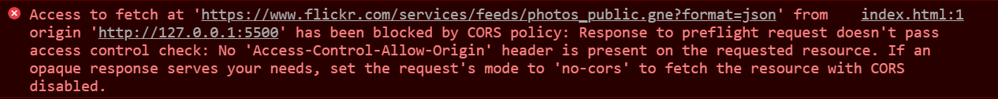
Making Cross Origin Requests
Introduction to Cross Origin Resource Sharing (CORS)
So far, all our examples work because they make requests to an API that allows cross-origin requests.
For security reasons, many APIs don’t allow cross origin requests. As a result, you’ll get an error like the one below if you try to make one:
For security, browsers enforce a same origin policy for client-side code. This means JavaScript code from one origin (protocol, domain, and port) can’t request a resource from another origin. For instance, JavaScript code at http://mysite.com can’t request a resource from an API at https://yourapi.com.
Fortunately, browsers have a mechanism that allows exceptions to the same origin policy….

Slide 48
Making Cross Origin Requests
Introduction to Cross Origin Resource Sharing (CORS)
Browsers use Cross Origin Resource Sharing (CORS) to check whether JavaScript is allowed to make cross-origin requests. To do that, CORS requires the server that’s hosting the API to include an Access-Control-Allow-Origin header in the HTTP response that it returns. Two example of these headers are outlined here:
A CORS header that allows a specific cross-origin request
Access-Control-Allow-Origin: https://example.com
A CORS header that allows any cross-origin request
Access-Control-Allow-Origin: *
The first authorizes a cross-origin request from a specific website.
The second uses the * character to authorize requests from any website.

Slide 49
Making Cross Origin Requests
Options for bypassing the CORS policy
In the past, some developers used iframes or JSON with padding (JSON-P) to trick the server into thinking that another server was making the request.
These techniques aren’t recommended for modern development. These days, it’s generally considered a best practice to solve this issue by using a server-side proxy. Proxies use code that runs on the server to request data from the API and then displays it in a web page that has the same origin as your client-side application. Then, your application can use an Ajax request to get the data from that web page.
Creating your own server-side proxy is generally considered the best way to solve this issue. For example, you could use Node.js to run JavaScript on the server.
Third-party proxies function similarly. For example, CORS Anywhere is a freely available proxy that you can use and is described in the demos. In general, using a third-party proxy isn’t secure enough for a production applications. However, it’s useful for quickly developing a prototype or testing an API.

Slide 50
Making Cross Origin Requests
Using a third-party proxy to bypass CORS
async function fetchUsers() {
const proxy = 'https://cors-anywhere.herokuapp.com/';
const api = 'https://www.flickr.com/services/feeds/photos_public.gne?format=json';
const url = proxy + api;
const response = await fetch(url, {
headers: {'Content-Type': 'application/json','Accept': '*/*',}
});
const images = await response.json();
console.log(images);
}
fetchUsers();

Slide 51
Lab 18 The (Console-Based) Employee Management Application v2

